Slide 1

IT & DA Team Meeting – August
August 26, 2021

Slide 2
General Updates
Lynn Atkin
August Birthdays and Work Anniversaries
IAST
Kim Kowalewski
Open Forum
Team
Meet and Greet – David Chavez
Team

Slide 3
General Updates Lynn Atkin

Slide 4

Birthdays
Aerozona – 8/14
Sol – 8/31
Lynn – 8/31

Slide 5

Work Anniversaries
Michael Bavasso – 16 years on 8/22
Congrats on 16 years Michael!

Slide 6

Certifications
Congrats to Saurabh for passing the CISA exam this month!

Slide 7
IAST Kim Kowalewski

Slide 8
Open Forum

Slide 9
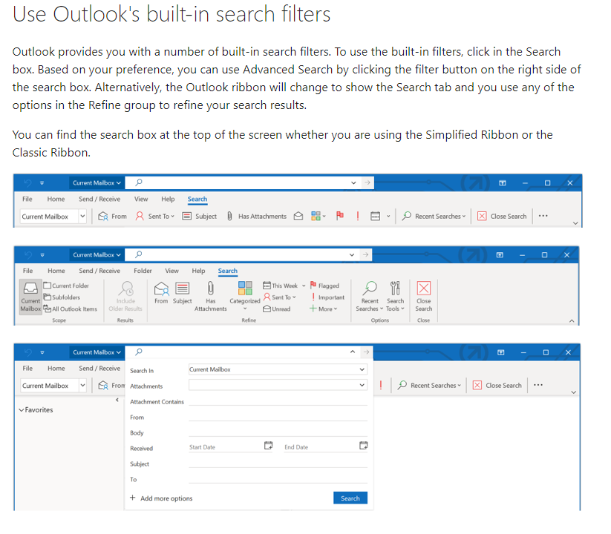
Tips and Tricks for AuditBoard or other tools
Outlook Search Function – Daniel
AuditBoard - Team

Slide 10
Monthly Meeting Presenters
Upcoming PTO
Name​ | Dates
Aerozona Obiadazie | Sept 1-3
Terri Quiambao | Sept 3 & 7
Konrad Wisniewski | Sept 7
Michael Bavasso | Sept 7-10
Saicharan Sirangi | Sept 10
Jason Nazare | Sept 20
Matthew Colville | Sept 21-23
Eric Baba | Sept 22
Name​ | Month
Seun Mafi | September

Slide 11
Meet and Greet – David Chavez Team

Slide 12

Question 1 – What’s David’s favorite sport?
A. Baseball
B. Soccer
C. Formula 1
D. Cricket

Slide 13
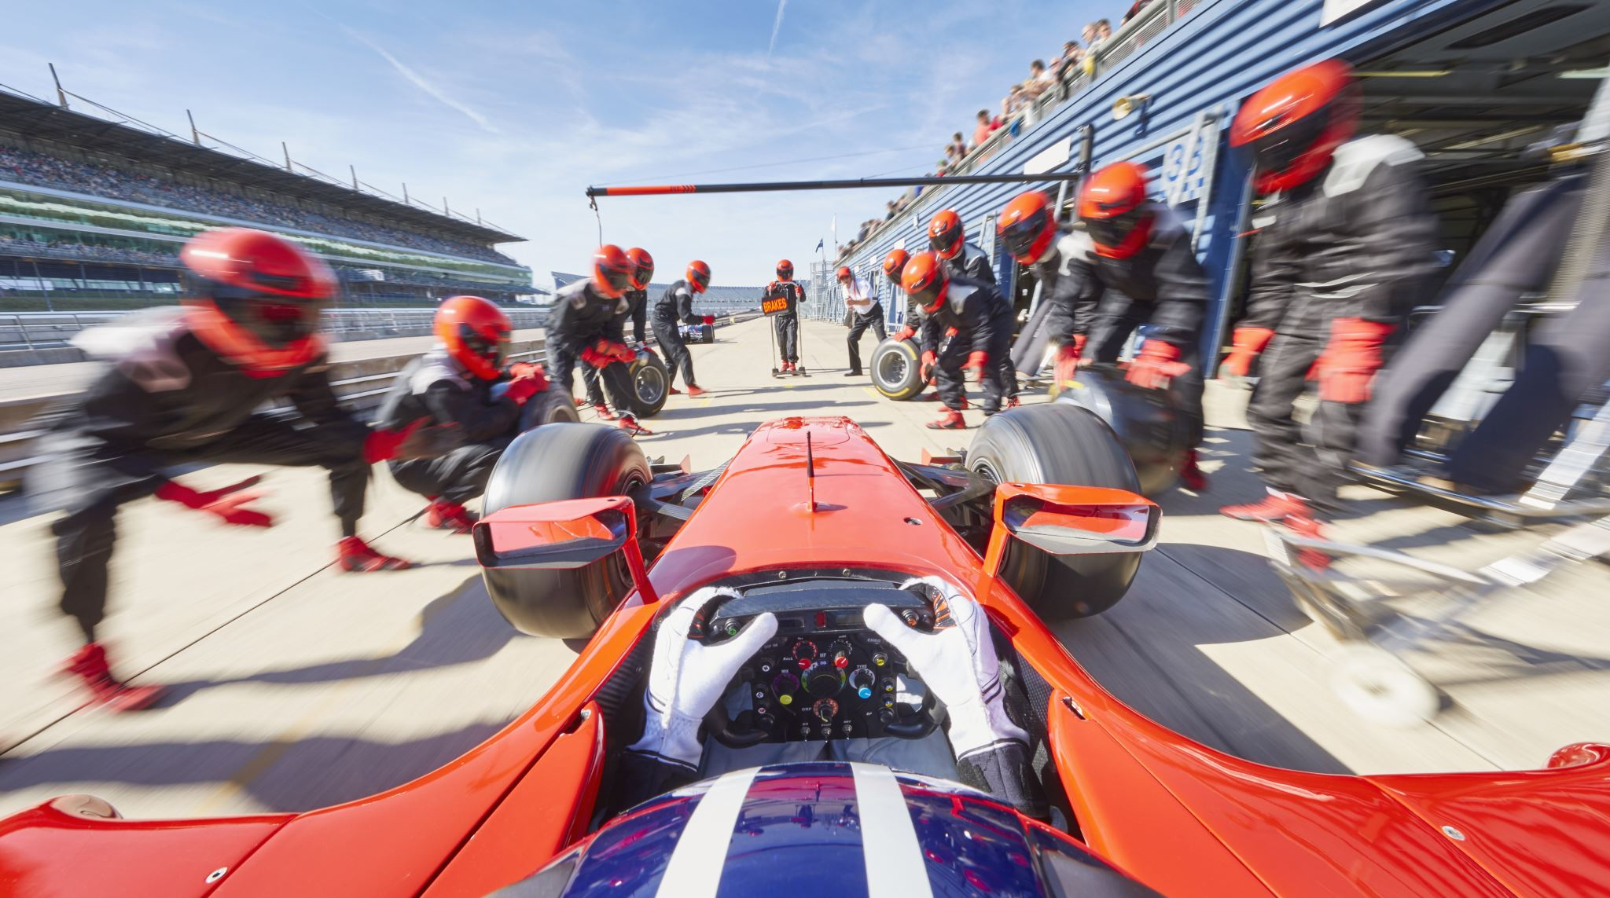
Answer - Formula 1

Slide 14
Question 2 – What’s David’s favorite vacation spot?
A. LA, California
B. Cancun, Mexico
C. Barcelona, Spain
D. Aruba

Slide 15
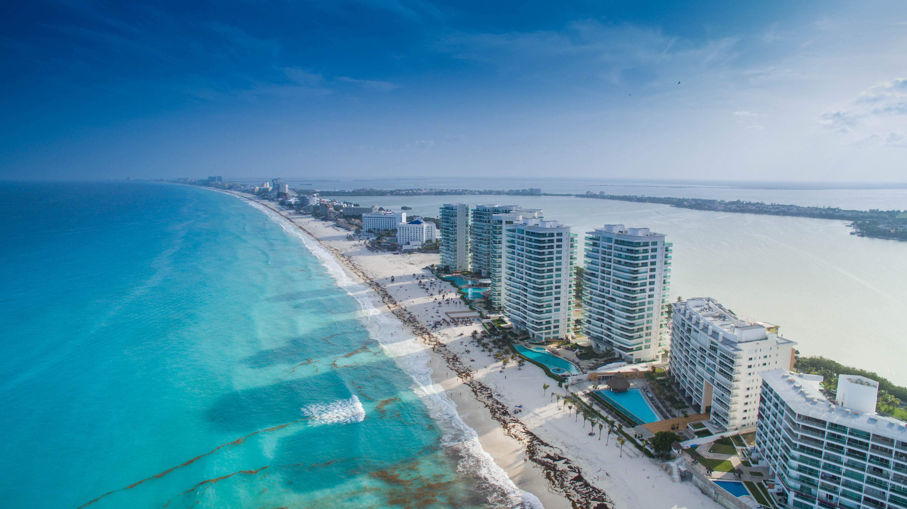
Answer – Cancun, Mexico

Slide 16
Question 3 – What’s David’s favorite hobby?
A. Dancing
B. Puzzles
C. Running
D. Skeet Shooting

Slide 17
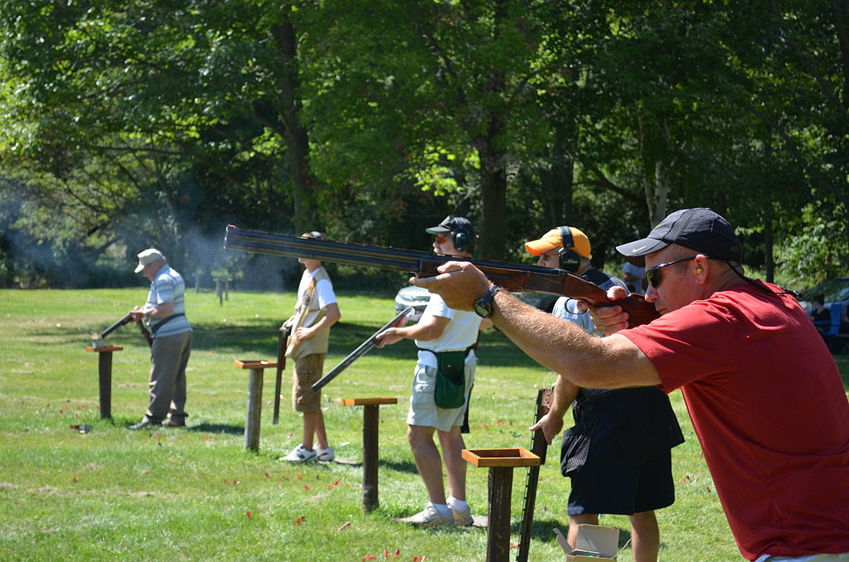
Answer – Skeet Shooting

Slide 18
Question 4 – What kind of pets does David have?
A. Cats
B. Dogs
C. 1 Dog & 1 Cat
D. Iguanas

Slide 19
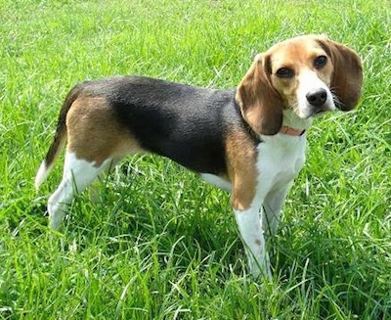
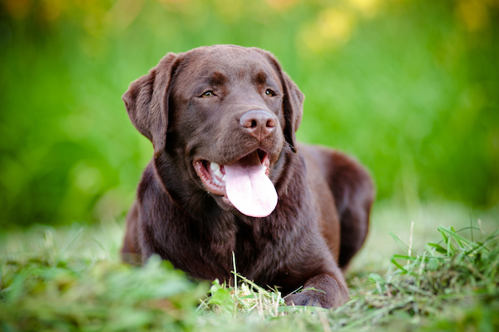
Answer – Dogs More specifically a tricolor beagle and a chocolate lab

Slide 20
Question 5 – What’s David’s favorite meal?
A. BBQ
B. Fried Chicken
C. Tacos Al Pastor
D. Hawaiian Pizza

Slide 21
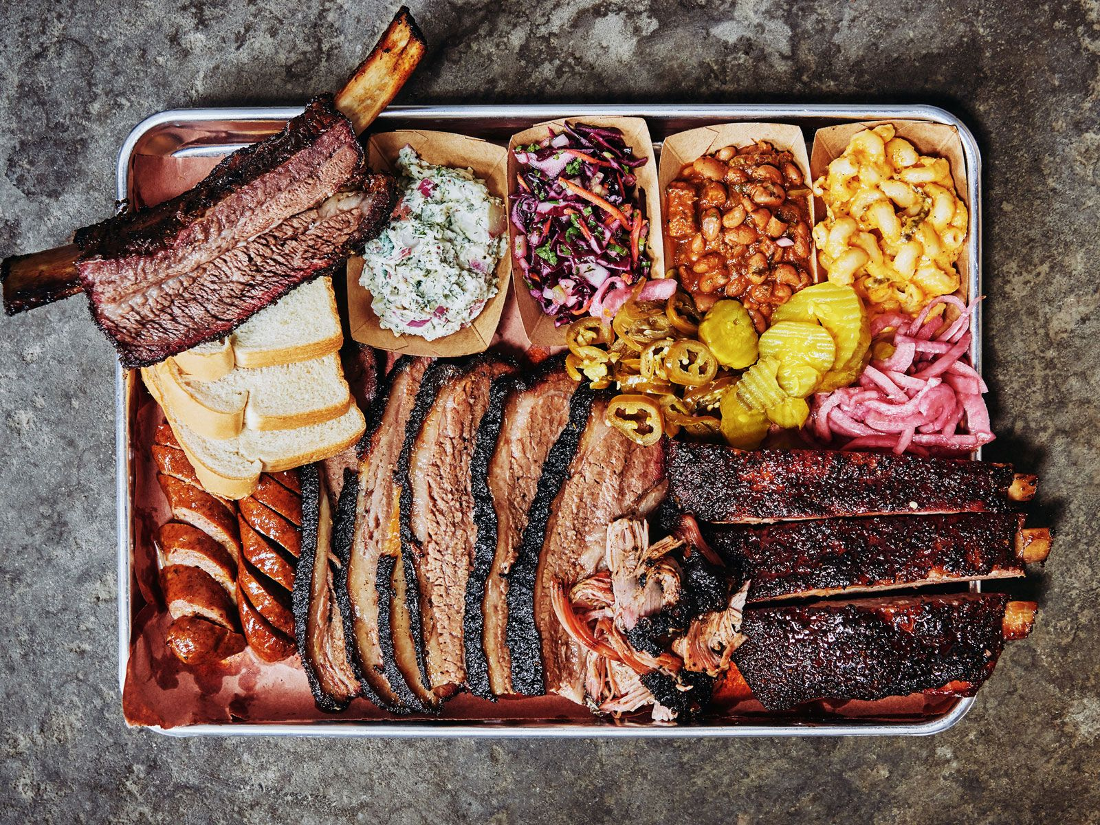
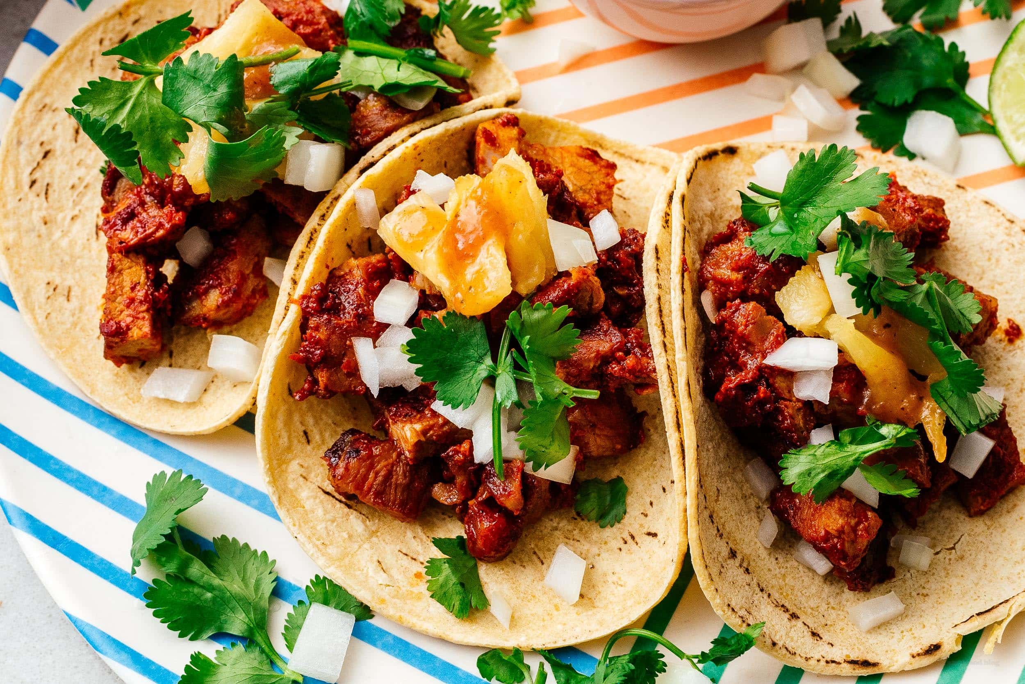
Answer – BBQ and Tacos Al Pastor

